Slide 1
NEURAL NETWORKS PROJECT
Lucía Corpas
Javier Jordán
Illya Rozumovsky
Jorge Velázquez

Slide 2
Introduction
In this project, we have learned a function from several training patterns by using a multilayer perceptron neural network. The function that we have used has two real numbers (x,y) as inputs and a single real number as output:
F(x,y) = sin(x) * cos(y)
We assume that both inputs belong to the interval [-pi,pi]. The output is in the interval [-1,1].
We use the Encog library as the implementation of the multilayer perceptron:
https://www.heatonresearch.com/encog/

Slide 3
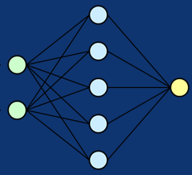
Encog Library
The Encog Library is a pure-Java/C# machine learning framework that was created back in 2008 to support genetic programming and other neural network technologies.
The source code for Encog can be much simpler to adapt for cases where you want to implement the neural network yourself from scratch. Some of the less mainstream technologies supported by Encog include NEAT, HyperNEAT, and Genetic Programming. Encog has minimal support for computer vision.
Encog supports a variety of advanced algorithms, as well as support classes to normalize and process data. Machine learning algorithms such as Support Vector Machines, Neural Networks, Bayesian Networks, Hidden Markov Models, Genetic Programming and Genetic Algorithms are supported. Most Encog training algorithms are multi-threaded and scale well to multicore hardware.

Slide 4
PROJECT STEPS
01
02
03
Generate at random 1000 training samples of the function
Generate at random 1000 validation samples of the function
Train a multilayer perceptron with the 1000 training samples of the function
Generate the samples of (x,y) uniformly at random on the square [-pi,pi] x [-pi,pi]. Then compute the value of the function F(x,y) at those points.
Generate the samples of (x,y) uniformly at random on the square [-pi,pi] x [-pi,pi]. Compute the value of the function F(x,y) at those points.
Choose the number of hidden neurons, the learning parameters, and the number of epochs. The training error and the validation error must be printed out for each training epoch.

Slide 5
PROJECT STEPS
04
05
06
Generate test samples of the function
Simulate the multilayer perceptron on the test samples
Generate error plots
Generate the test samples of (x,y) at equally spaced locations in a grid of 100x100 points on the square [-pi,pi] x [-pi,pi]. Then compute the value of the function F(x,y) at those points.
Compute the mean squared error for the test samples, and print it out on the console
Generate a plot to show the evolution of the training error and the validation error at each training epoch

Slide 6
Program code

Slide 7
ERROR PLOTS
To check which is the best setting for the neural network, we have done several error plots. We have chosen between two different activation functions:
Activation LOGARITHM
ELLIOTT SYMMETRIC
After seeing all possible plots, we choose the one which adapts better to our requirements.

Slide 8
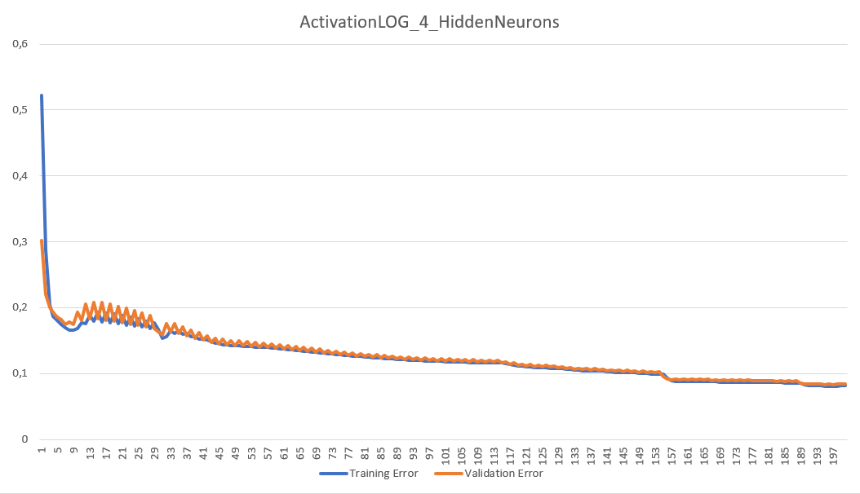
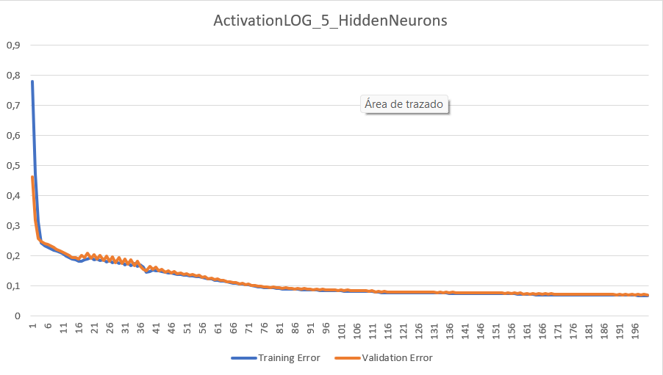
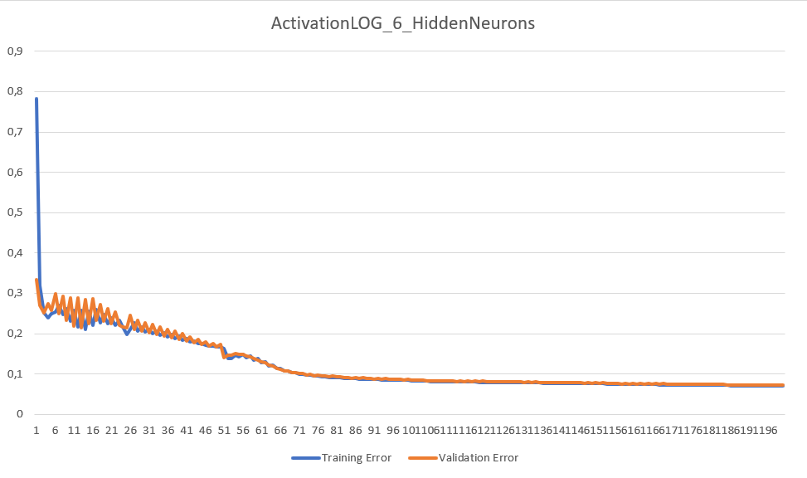
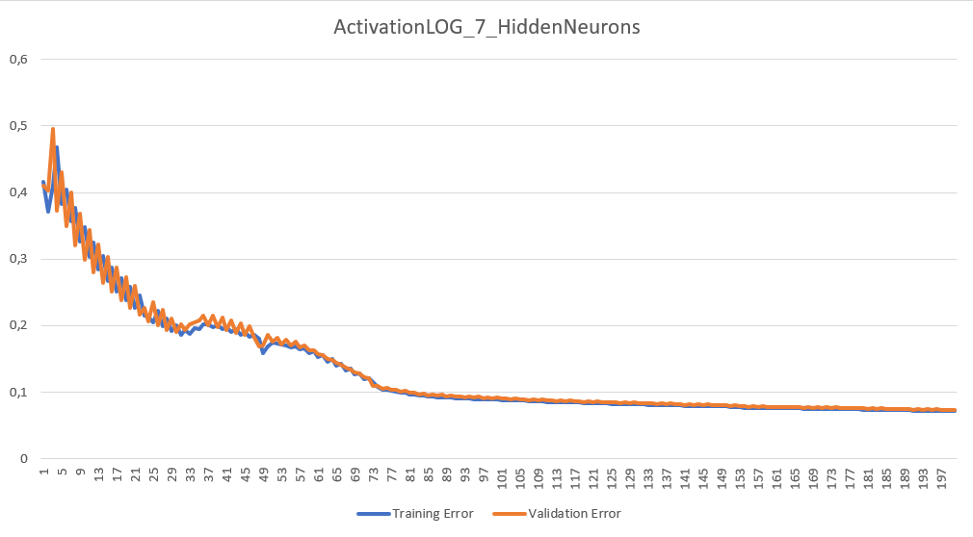
Activation logarithm

Slide 9
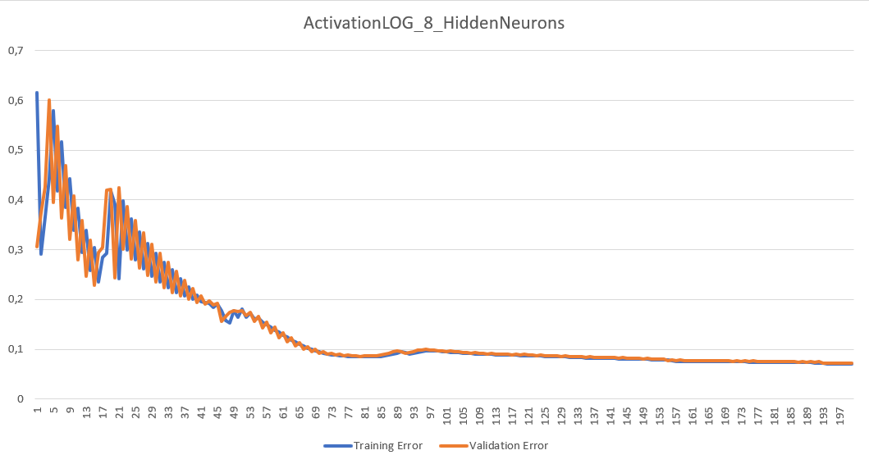
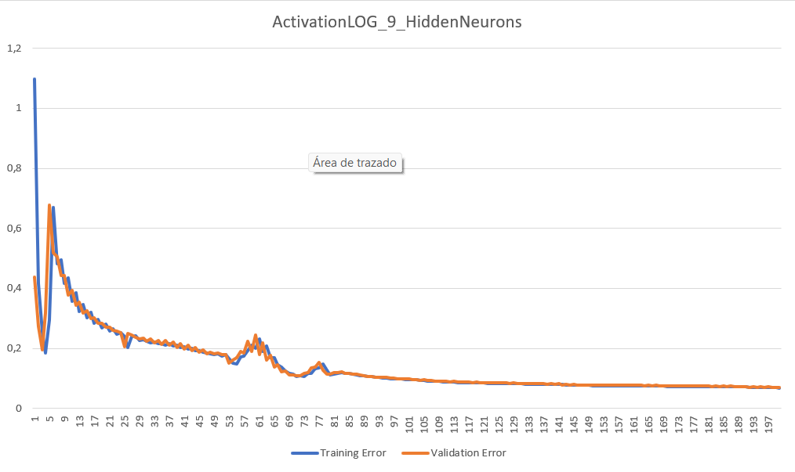
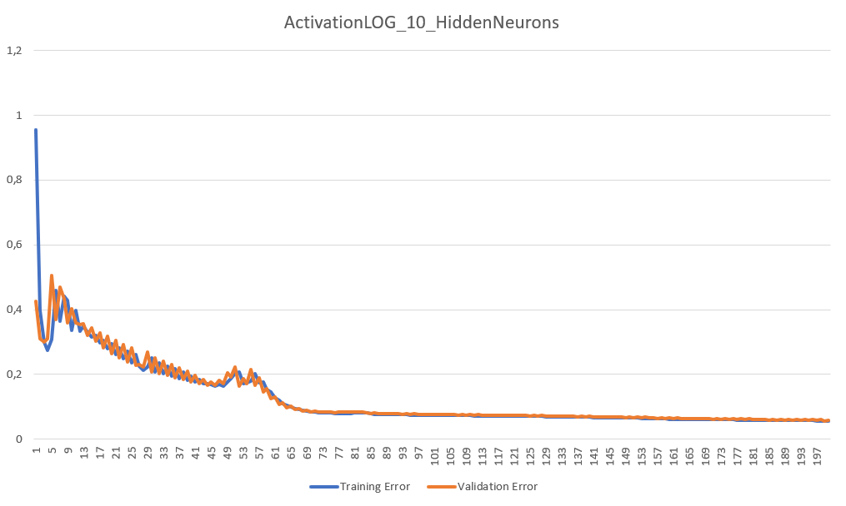
ACTIVATION LOGARITHM

Slide 10
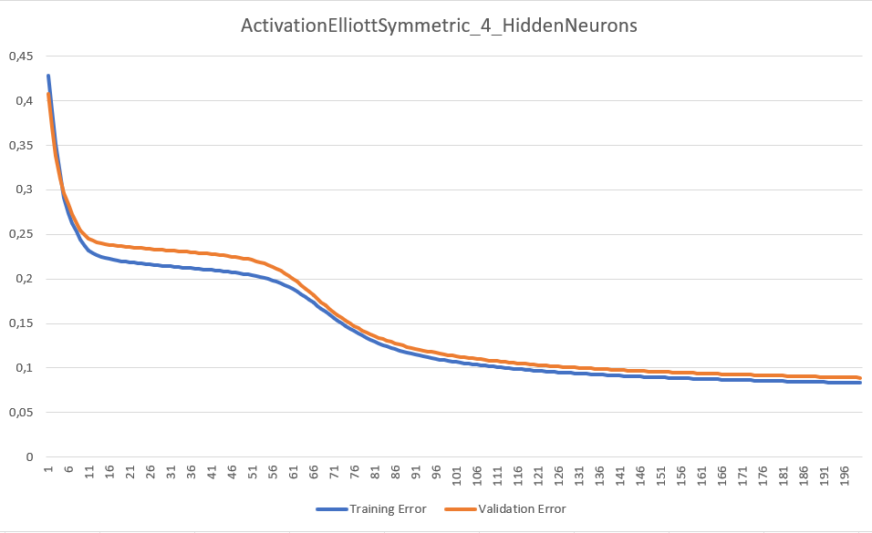
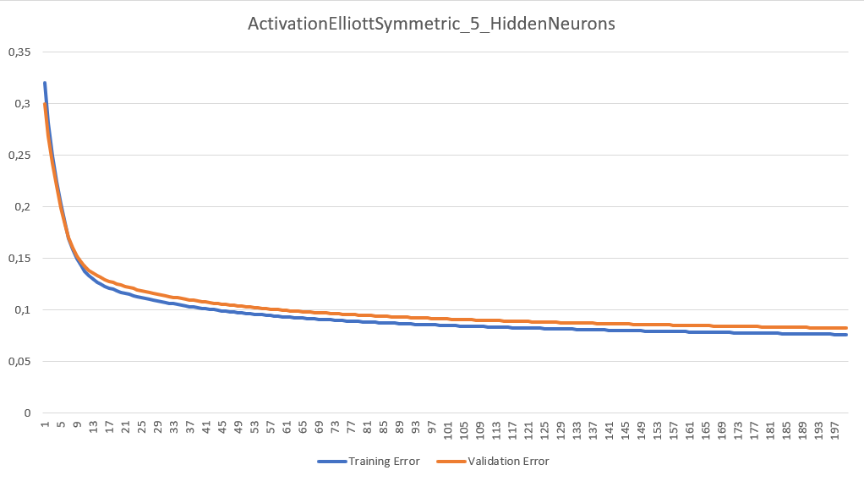
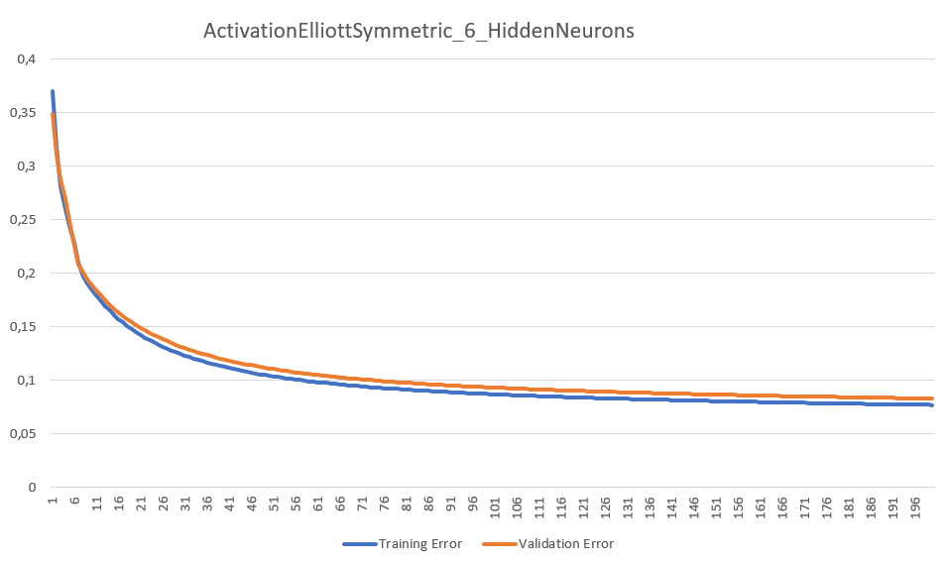
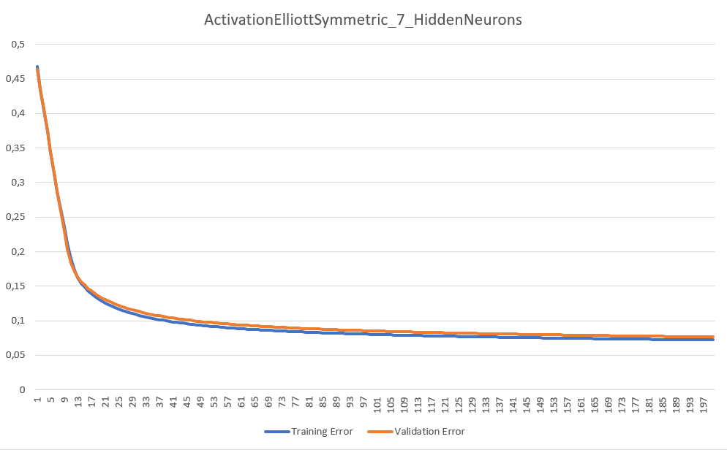
elliott symmetric

Slide 11
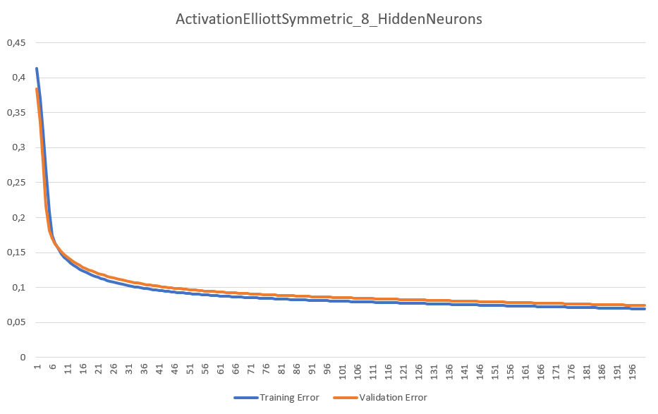
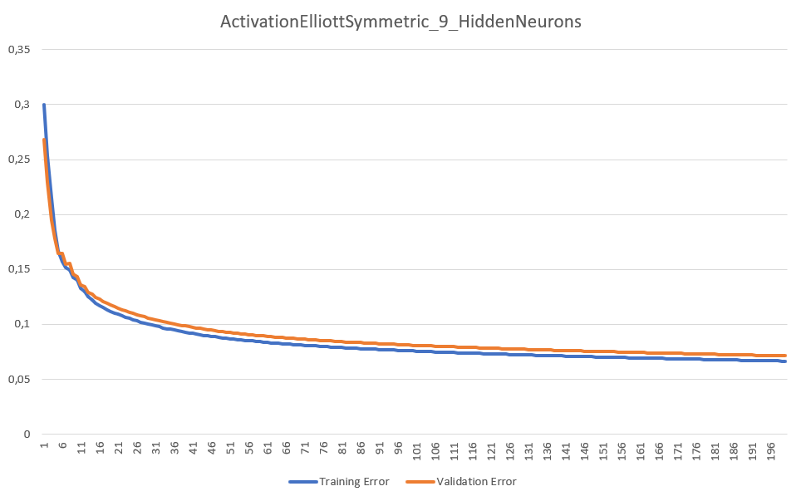
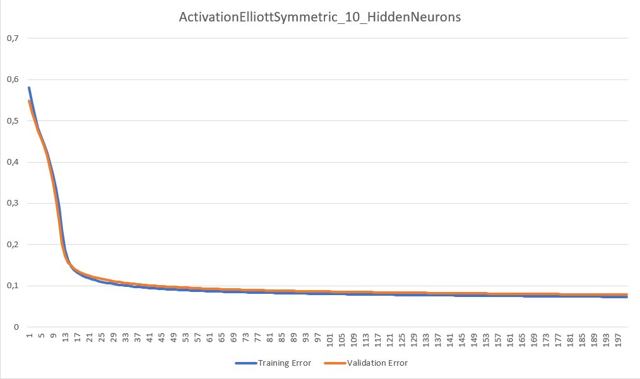
elliott symmetric

Slide 12
SELECTED PLOT
The selected plot is the number 10 with Activaiton Elliott Symmetric, because it is the one that show us the minimum validation error with the minimum number of iterations. This one in particular, reaches an error of 0,1 with around 35 iterations.

